Slide 1
Overview and Airinterface of LTE (Long Term Evolution)
2015
Instructor : Mohammad Rasoul Tanhatalab
m_r_tanha@yahoo.com

Slide 2
LTE Architectural Review
Section 1 – Introduction to LTE
Evolution of Mobile Broadband
LTE Capabilities and Services
Comparison of Mobile Broadband
LTE Market Analysis
Section 2 – Service Architecture
Evolution (SAE)
Basic Network Architecture
Network Node Functions
eNB, MME, S-GW, P-GW
SAE Interfaces
S1-U, S1-MME, X2
Inter-Working Architectures
Trusted Access
Non-Trusted Access
3GPP inter-working
Section 3 – LTE Radio Interface
Broadband Wireless Requirements
Multi-Carrier Radio Channels (OFDM)
Structure and Timing of LTE Radio
LTE Logical/Transport/Physical Channels
LTE Reference Signals
MIMO in LTE
Section 4 – Introduction to LTE Protocols
Physical Layer
MAC Layer
RLC Layer
PDCP Layer
Radio Control Protocols (RRC)
Section 5 – LTE Procedures
Radio Resource Management
Network Entry and Registration
Mobility Procedures
Cell Selection/Reselection
Handover
Location Management
Data Session Procedures
Permanent Bearer
QoS
Section 6 – Service Provision in LTE
Requirements for LTE Services
IP Multimedia Sub-System (IMS)
VoIP and IMS
Voice and VoLGA in LTE

Slide 3
Section 1 Introduction to LTE
Evolution of Mobile Broadband
LTE Capabilities and Services
Comparison of Mobile Broadband
LTE Market Analysis

Slide 4
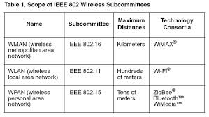
IEEE 802 Standards

Slide 5
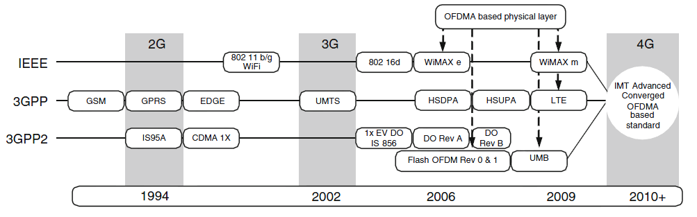
Standardization bodies
3GPP:
The 3rd Generation Partnership Project (3GPP) is European standardization body (“GSM” family),
3GPP2:
3GPP2 is a collaborative effort between some officially reorganizations In North America and Asia East (china and Japan)
IEEE
Institute of Electrical and Electronics Engineers is data networks standards (“802.xx” family),
ITU
Definition of the characteristics of the generation (2, 3, 4, …), validation of proposed standards and allocation of spectrum

Slide 6
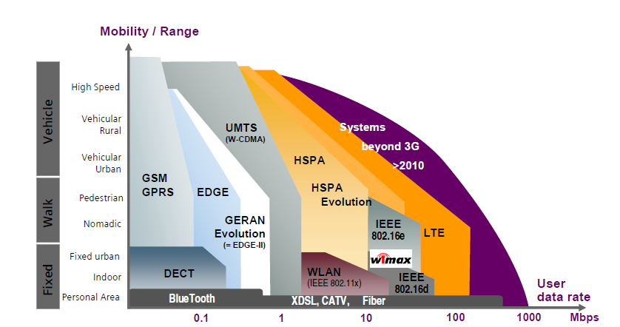
Comparison of technologies in Mobility and Throughput

Slide 7
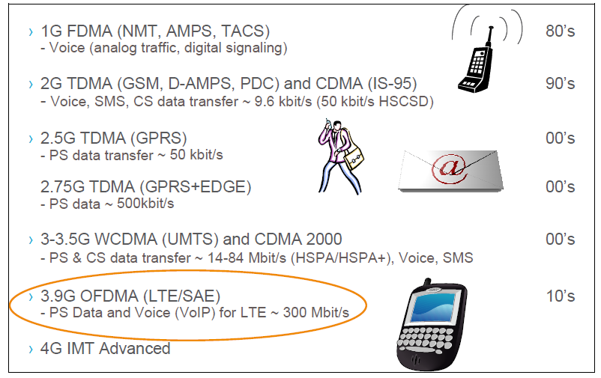
Briefly summarizes the history of cellular technologies

Slide 8
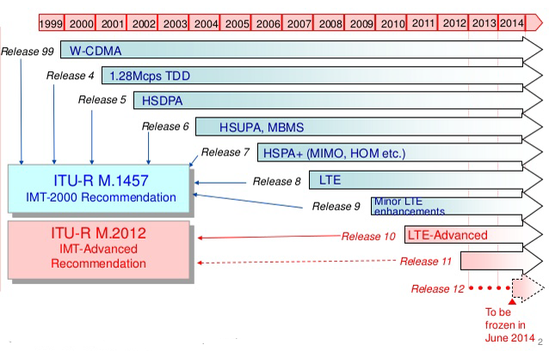
Release of 3GPP Specifications

Slide 9
The key features of LTE
Peak download rates up to 300 Mbit/s and upload rates up to 75 Mbit/s
Low data transfer latencies (U-Plane and C-Plane) lower latencies for handover and connection setup.
Improved support for mobility, exemplified by support for terminals moving at up to 350 km/h or 500 km/h depending on the frequency band.
OFDMA for the downlink, SC-FDMA for the uplink to conserve power
Support for both FDD and TDD communication systems
Support for all frequency bands currently used by IMT systems by ITU-R.
Increased spectrum flexibility: 1.4 MHz, 3 MHz, 5 MHz, 10 MHz, 15 MHz and 20 MHz wide cells are standardized.
Higher spectral efficiency.
Support for cell sizes from tens of meters radius up to 100 km radius Macro-cells
Simplified architecture: The network side of E-UTRAN is composed only of eNodeBs
Support for inter-operation and co-existence with legacy standards (e.g. GSM/EDGE, UMTS and CDMA2000). Users can start a call or transfer of data in an area using an LTE standard, and, should coverage be unavailable, continue the operation without any action on their part using GSM/GPRS or W-CDMA-based UMTS or even 3GPP2 networks such as CDMA One or CDMA2000)
Packet switched radio interface.
Support for MBSFN (Multicast-Broadcast Single Frequency Network). This feature can deliver services such as Mobile TV using the LTE infrastructure, and is a competitor for DVB-H-based TV broadcast.
Capacity – 200 users for 5MHz (active state)

Slide 10
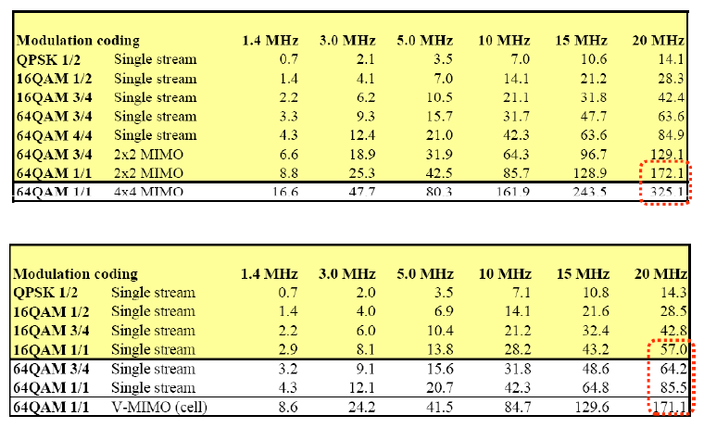
Peak data rates DL and UL

Slide 11
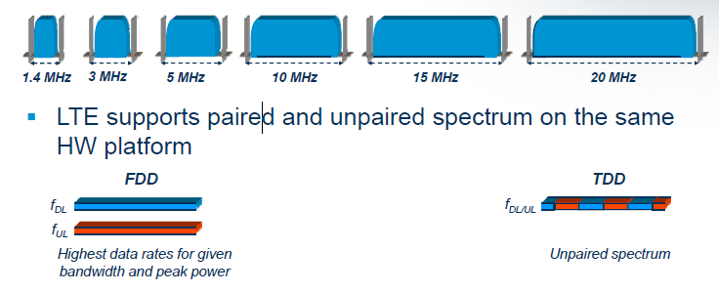
Spectrum Flexibility

Slide 12
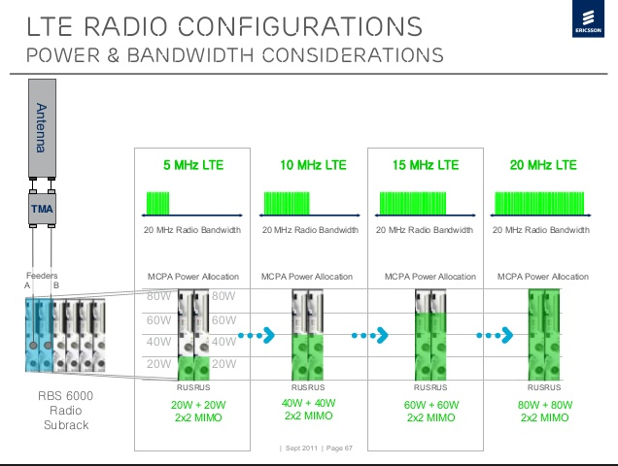

Slide 13
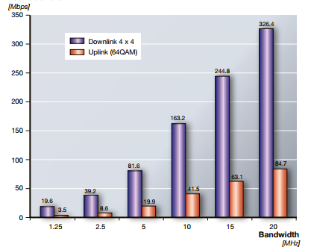
Maximum Throughput based on Bandwidth

Slide 14
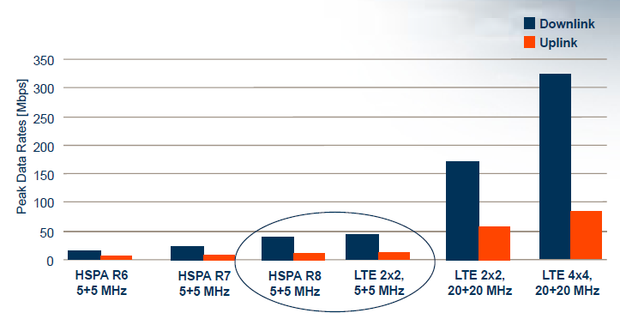
Peak Data Rates

Slide 15
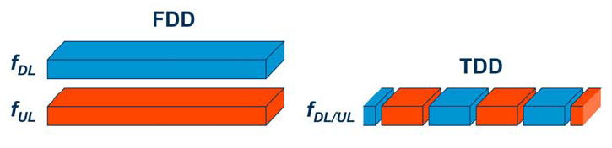
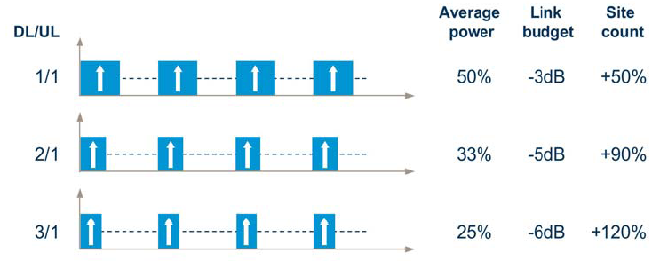
TDD and FDD

Slide 16
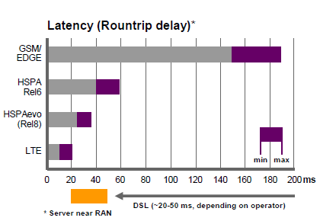
Latency

Slide 17
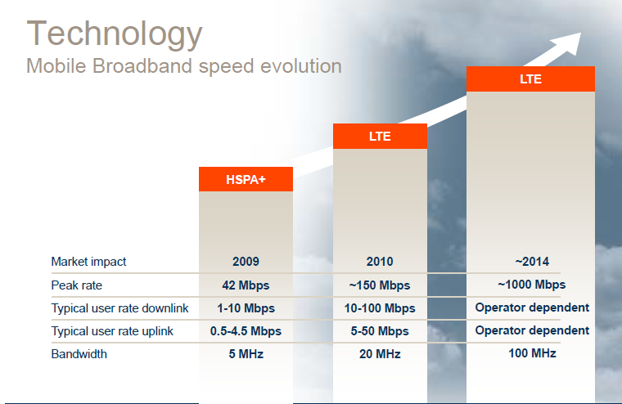

Slide 18
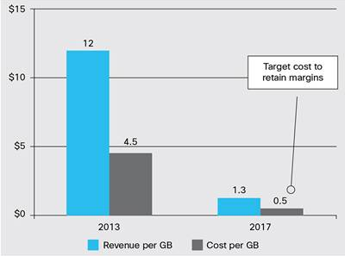
Blended Traffic Revenue and Cost (Source: Analysis Mason/Cisco Research)

Slide 19
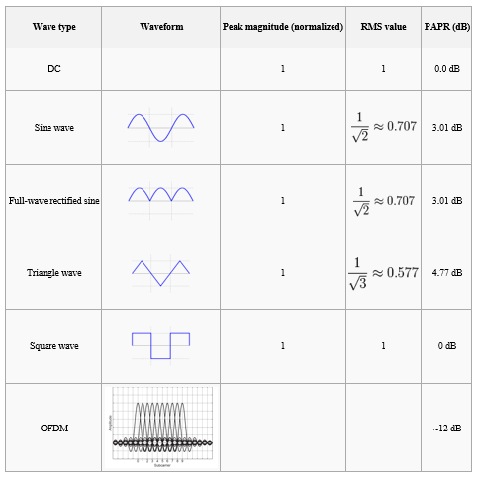
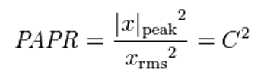
peak-to-average power ratio (PAPR)

Slide 20
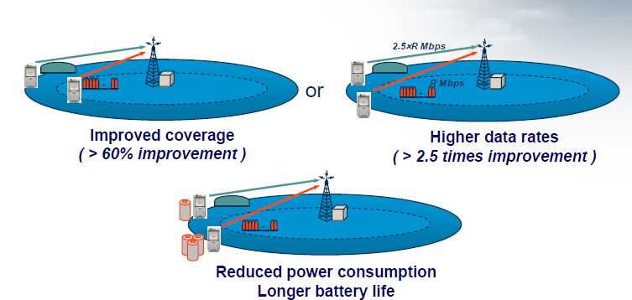
SC-FDMA Compared to ordinary OFDM

Slide 21
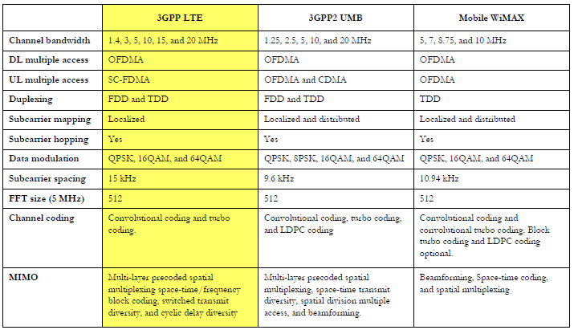
Comparing LTE, WiMAX, UMB

Slide 22
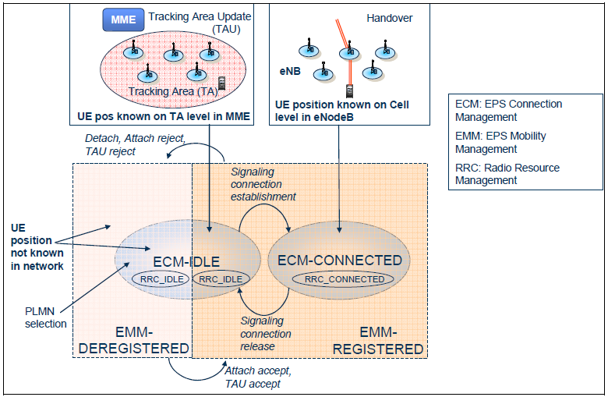
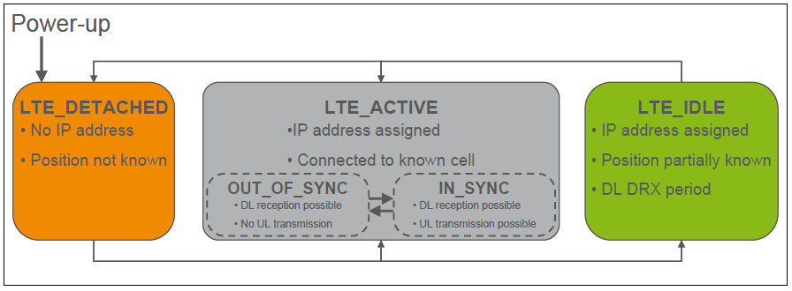
LTE UE states

Slide 23
RRC States
RRC IDLE state UE can
Receive broadcast/multicast data
Monitors a paging channel to detect incoming calls
Performs neighbor cell measurements
Cell selection/reselection
Acquires system information
Specific DRX (discontinuous reception) cycle may be configured by upper layers to enable UE power savings
Mobility is controlled by the UE in the RRC IDLE state
RRC CONNECTED state
The transfer of unicast data to/from UE
The transfer of broadcast/multicast data to UE
The UE may be configured with a UE specific DRX/DTX (discontinuous transmission)
UE monitors control channels associated with the shared data channel to determine if data is scheduled for it
Provides channel quality feedback information
Performs neighbor cell measurements and measurement reporting
Acquires system information
The mobility is controlled by the network in this state.

Slide 24
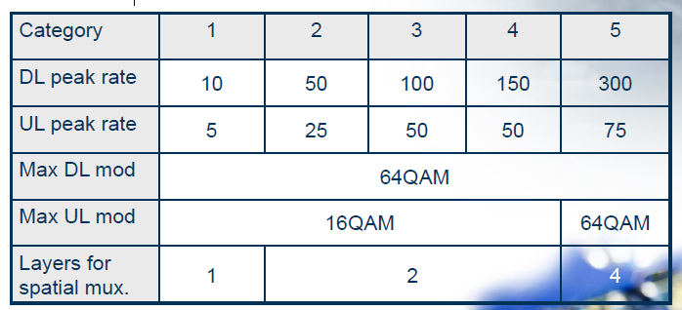
UE categories

Slide 25

Sample of devices that might include an LTE chipset

Slide 26

Section 2 Service Architecture
Evolution (SAE)
Basic Network Architecture
Network Node Functions
eNB, MME, S-GW, P-GW
SAE Interfaces
S1-U, S1-MME, X2
Inter-Working Architectures
Trusted Access
Non-Trusted Access
3GPP inter-working

Slide 27
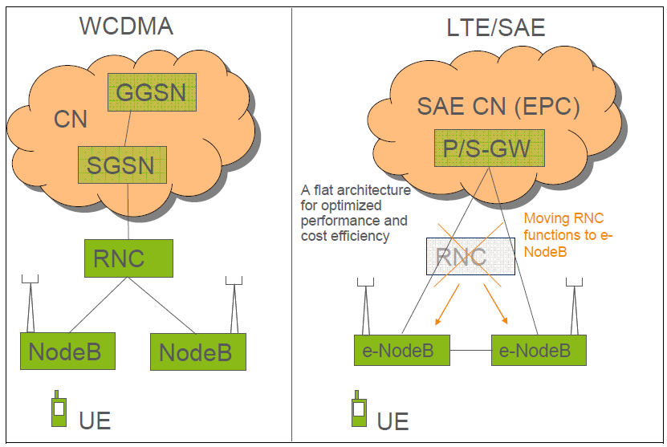
Simplified Network Architecture

Slide 28
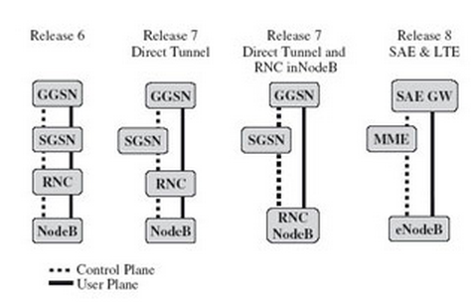
Different 3GPP releases

Slide 29
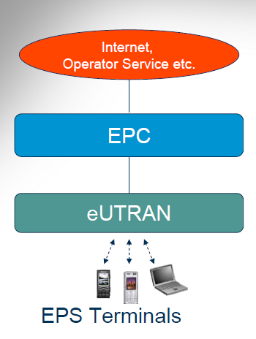
EPS

Slide 30
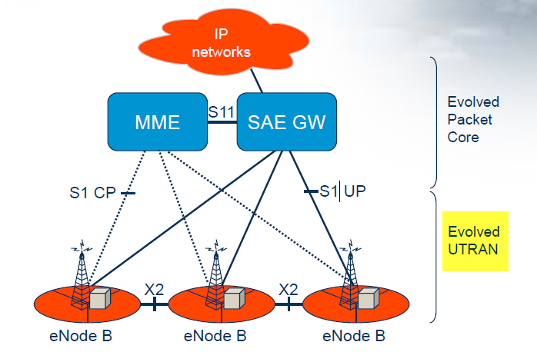
EPS
Evolved Packet Core (EPC) o Serving Gateway (SGW) o Mobility Management Entity (MME) o Packet Data Network Gateway (PDN GW)

Slide 31
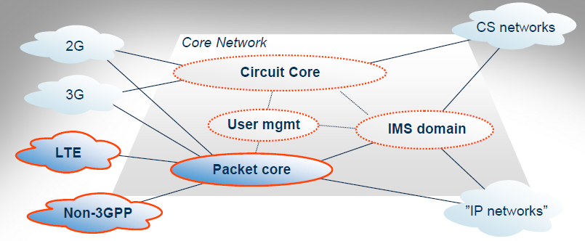
All Wireless Generations

Slide 32
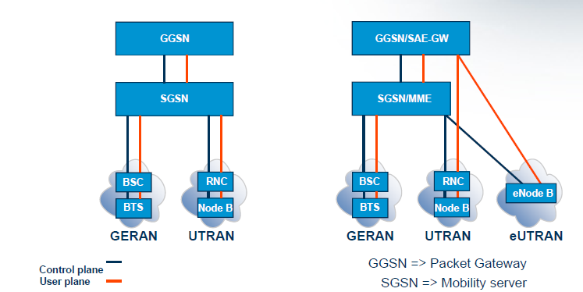
2G, 3G and LTE

Slide 33
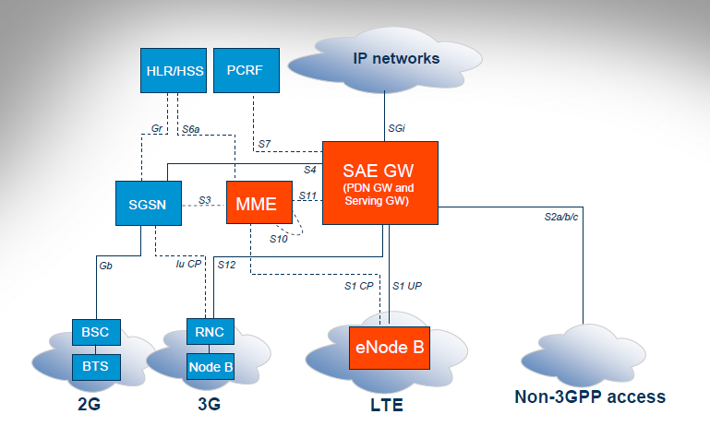
EPS Architecture

Slide 34
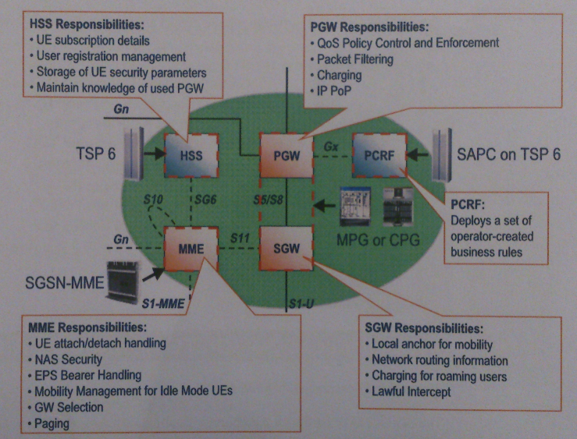
EPC nodes and responsibilities

Slide 35
eNB Functionality
Control and User Plane security
Shared Channel handling
Segmentation/Concatenation
HARQ
Scheduling
Multiplexing and Mapping
Physical layer functionality
Measurements and reporting
Automated operation and maintenance
Cell control and MME pool support
Mobility control

Slide 36
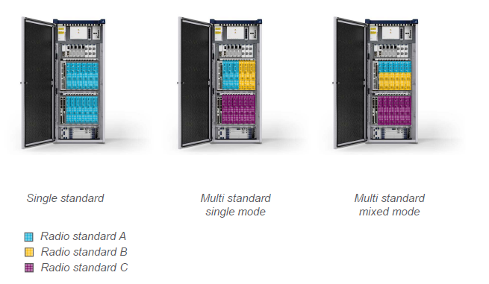
Single and Multi Standard in eNB

Slide 37
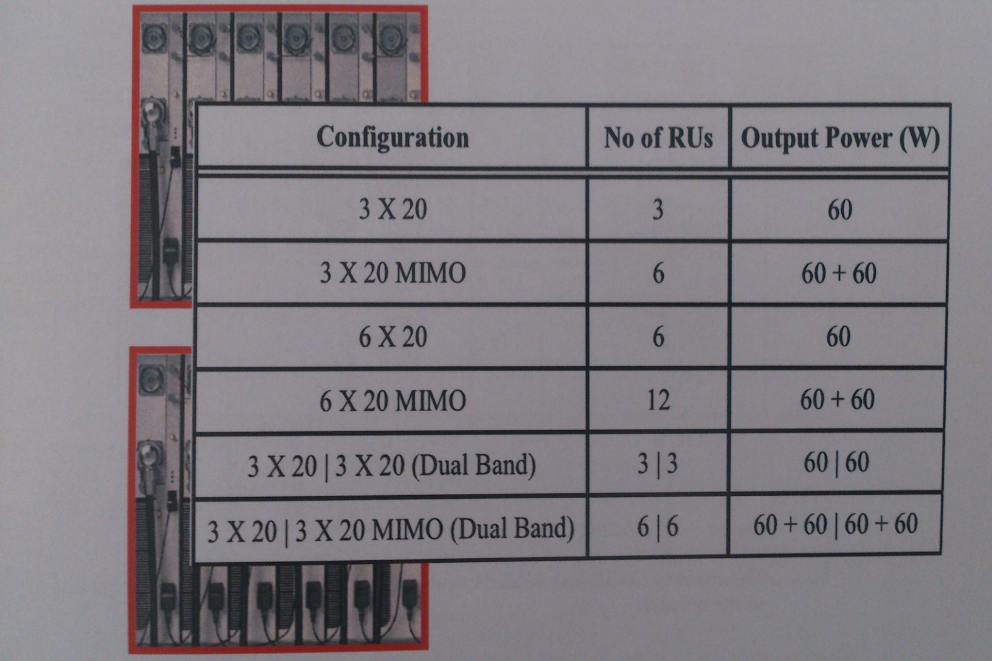
eNodeB Configuration

Slide 38
MME (Mobility Management Entity)
MME functions include:
UE attach / Detach handling
It allows UE to register and de-register to the network
Security
The MME implement functions for authentication and authorization to verify users as well as it performs ciphering and integrity protection of NAS message signaling
EPS Bearer Handling
The MME manages the setting up, modification and tearing down of EPS bearer.
Mobility management for idle mode UEs
Idle mode UEs are tracked with the granularity of Tracking Area

Slide 39
Policy and Charging Rules Function (PCRF)
The PCRF is a server that deploys a set of operator-created business rules.
These rules define how Network resources should be allocated to subscriber and application and under what conditions. And has role of charging for different services.
HSS (Home Subscriber Server)
The HSS is the database that hold the subscription information for UE. The HSS stores the location of the UE (on MME node level), and authentication parameters.
S-GW (Serving Gateway)
The S-GW routes the user plane communication from UE to the P-GW. It has following responsibility: Local anchor for mobility, Network routing information, charging for roaming users, lawful Intercept.
Packet Data Network Gateway (PDN-GW or P-GW)
It is the gateway between the internal EPS network and external IP networks. Calculate of charging based on the received information from PCRF. And has anchor mobility role by non-3GPP network.

Slide 40
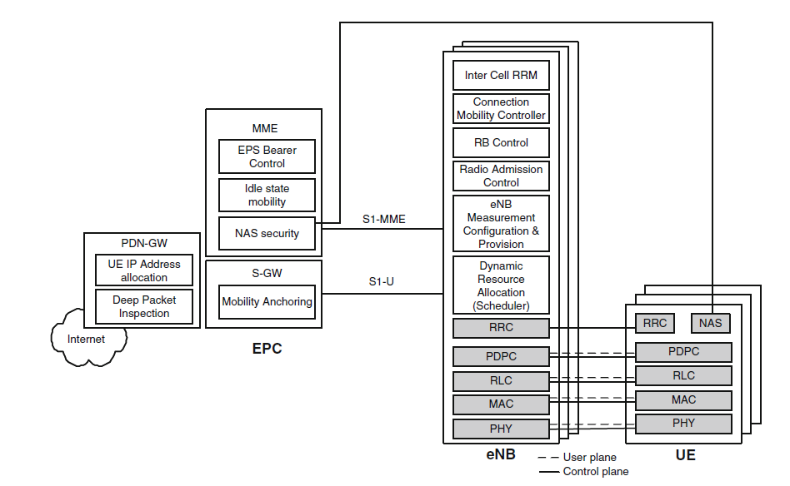
EPS Functions

Slide 41
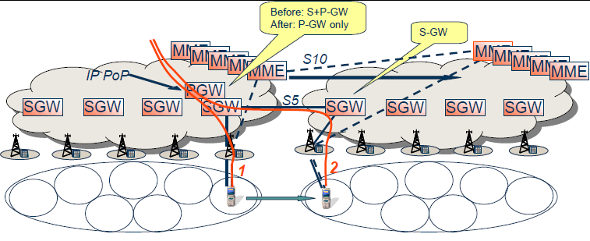
MME and S-GW Pooling

Slide 42
SON
Self Optimization
– Automated Neighbor Relations (ANR)
Self Configuration
– Plug & Play HW
– Automated Provisioning of RBS (APR)
Self Healing
– Fault Correlation
– Minimizes number of alarms

Slide 43
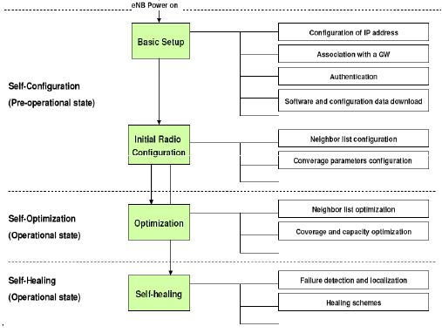
SON Process

Slide 44
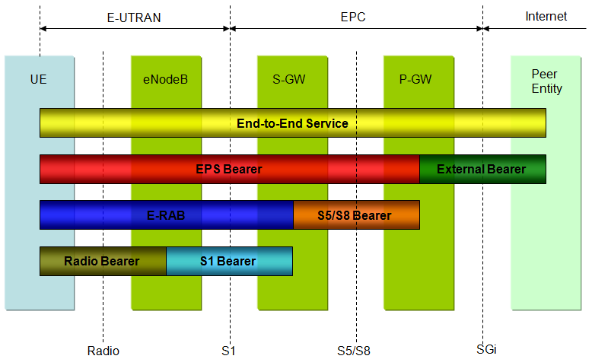
EPS bearer

Slide 45
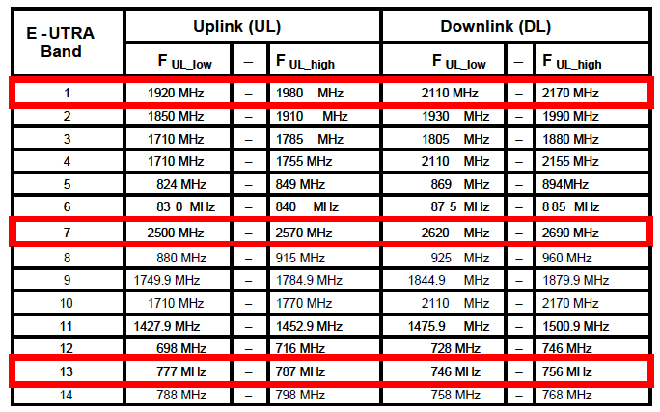
LTE FDD Frequency Bands
Ericsson LTE early releases will operate in E-UTRA band 1, 7 and 13

Slide 46
Section 3 LTE Radio Interface
Broadband Wireless Requirements
Multi-Carrier Radio Channels (OFDM)
Structure and Timing of LTE Radio
LTE Logical/Transport/Physical Channels
LTE Reference Signals
MIMO in LTE

Slide 47
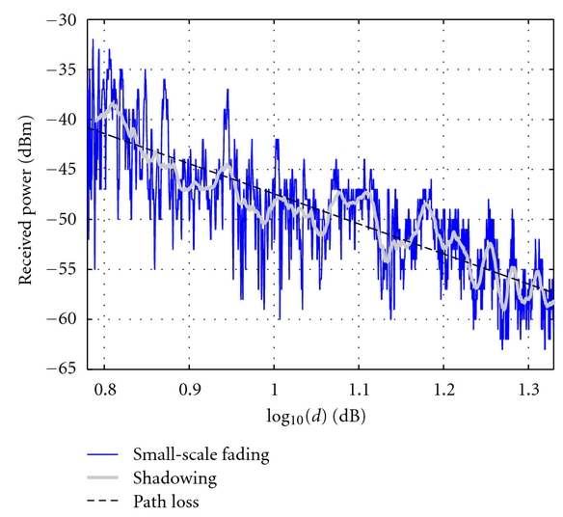
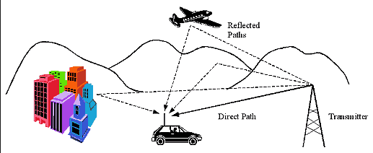
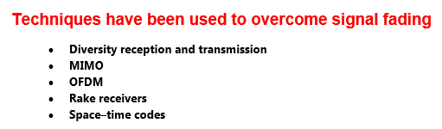
Type of Fading

Slide 48
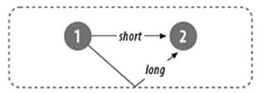
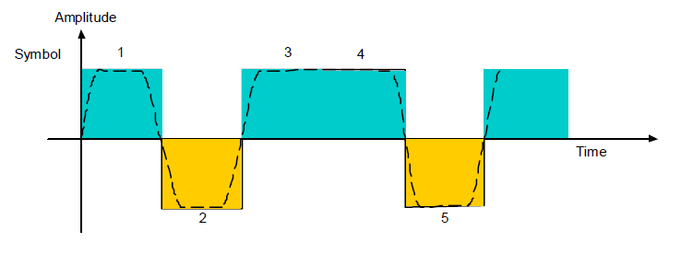
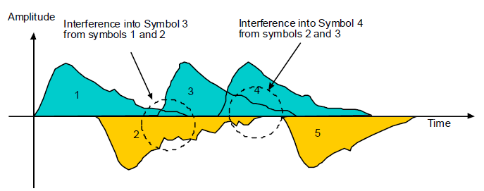
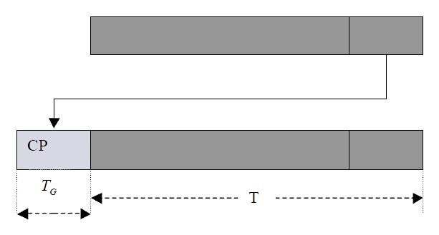
ISI (Inter-symbol interference)

Slide 49

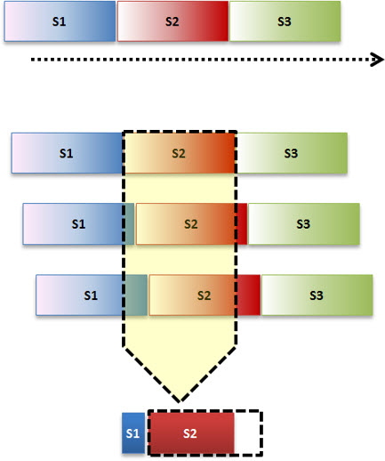
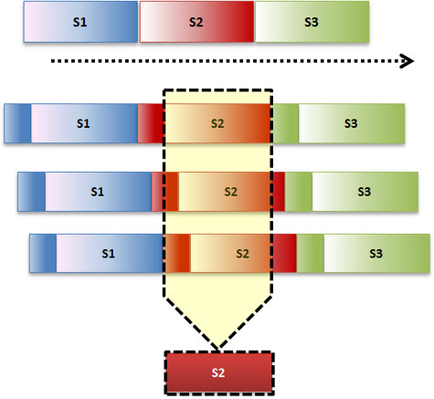

Slide 50
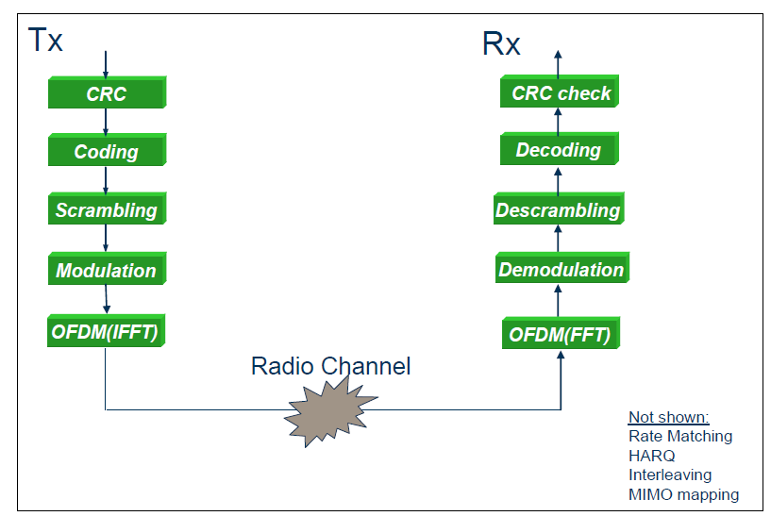
Tx & Rx physical layer processing

Slide 51
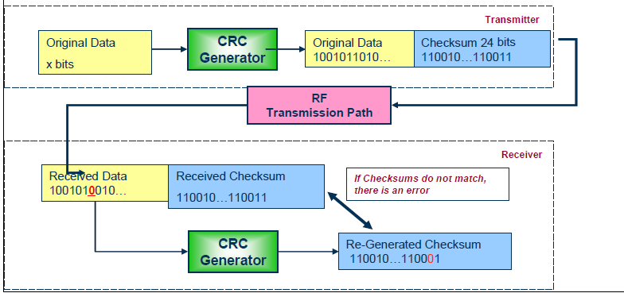
CRC (Cyclic-Redundancy Check) Coding

Slide 52
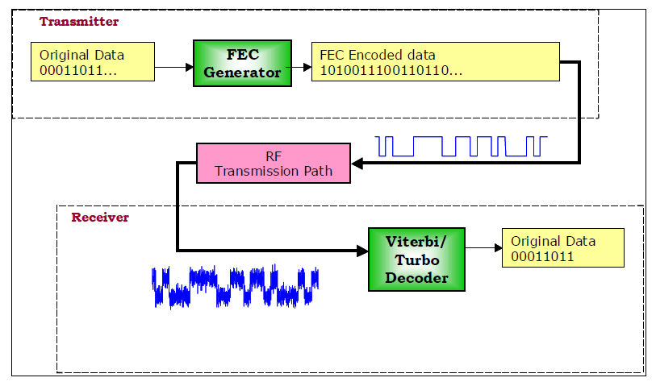
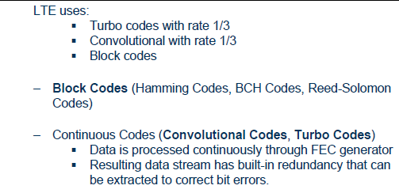
Forward Error Correction (FEC)

Slide 53

Adaptive Coding

Slide 54

Interleaving

Slide 55

MODULATION
The modulation process maps blocks of scrambled bits onto symbols.
BPSK (Binary Phase Shift Keying)is used for some signaling
QPSK (Quadrature Phase shift keying)
16-QAM (16 Quadrature Amplitude Modulation)
64-QAM (64 Quadrature Amplitude Modulation)

Slide 56

Adaptive Modulation

Slide 57

Scheduling
The principle behind DL Scheduling in LTE is to allocate UEs the RBs that have the highest S/N ratio and hence can use the highest order modulation, least coding and MIMO spatial multiplexing. The scheduling in this way give the most efficient use of the RF spectrum.

Slide 58


OFDM

Slide 59

OFDM and OFDMA

Slide 60


OFDM Block diagram

Slide 61

OFDM Blocks

Slide 62


Users given variable number of 15 kHz subcarriers in blocks of 12 (12X15 = 180 kHz) every 1 msec

Slide 63

The number of RBs (nRB) depends on the Channel Bandwidth (BWChannel)

Slide 64

Kinds of Sub-Carriers
Data sub-carrier
Pilot Sub-carrier (they are used to perform channel estimation)
DC sub-carrier (Direct Current Subcarrier is used by the mobile device to locate the center of the OFDM frequency band)
Guard Sub-carrier

Slide 65

TDD Sub-carrier

Slide 66

OFDMA Resource Block

Slide 67

Resource Element

Slide 68


SC-FDMA Vs. OFDMA

Slide 69

SC - FDMA

Slide 70

Uplink frequency hopping

Slide 71

Comparison of SC-FDMA and OFDMA

Slide 72

SC-FDMA Resource Block

Slide 73

UL Reference Signal
The two types of reference signals supported on the uplink include:
Demodulation reference signals (DMRS) used for channel estimation for PUSCH or PUCCH
Demodulation and sounding reference signals (SRS) used to measure the uplink channel quality for channel sensitive scheduling.

Slide 74
The active resource elements are used to carry the following traffic types:
• Downlink Reference Signals (channel estimation and CQI Measurements)
• Downlink L1/L2 Control signaling (for DL HARQ and scheduling info, UL scheduling, power commands)
• Synchronization Signals (Cell selection, time and frequency synchronization)
• Broadcast Control Channel (BCH)
• User plane data

Slide 75

SYNCHRONIZATION SEQUENCES
A User Equipment wishing to access the LTE system follows a cell search procedure which includes a series of synchronization stages by which the UE determines time and frequency parameters that are necessary to demodulate downlink signals, to transmit with correct timing and to acquire some critical system parameters.
the UE uses two special signals broadcast on each cell:
Primary Synchronization Sequence (PSS) Secondary Synchronization Sequence (SSS)
The detection of these signals allows the UE to complete time and frequency synchronization and to acquire useful system parameters such as cell identity, cyclic prefix length, and access mode (FDD/TDD).

Slide 76


PCI (physical cell ID) planning
PCI is combination of PSS and SSS. The 168 Physical-Layer Cell-Identity groups with 3 Physical-Layer Identities per group makes 168 x 3 = 504 Physical-Layer Cell Identities (PCI). Mathematically:
PCI = PSS + 3*SSS

Slide 77

PCI Confusion and PCI Collision
PCI confusion is when UE in an EUTRAN cell can hear two different neighbor EUTRAN cells with the same PCI and frequency
PCI collision is when an UE is in one EUTRAN cell and can hear another EUTRAN cell with the same PCI and frequency

Slide 78


Tracking Area (TA)
TAC: tracking area code
TAI: tracking area identity
TAU: tracking area update

Slide 79
System information split into two parts
Static part consisting of Master Information Block (MIB)
Transmission period = 40 ms
Transmitted on BCH
The MIB contains e.g. number of antennas, system bandwidth, PHICH configuration, transmitted power and scheduling information on how the SIBs are scheduled together with other data on DL-SCH.
Dynamic part consisting of System Information Blocks (SIB)
(SIB 1-8) mapped onto different RRC SI messages (SIs)
Period SI-1: 80 ms, Period SI-2: 160 ms, Period SI-3: 320 ms,
Transmitted on DL-SCH
SIB1 contains information on e.g. access related information and scheduling information on how the other SIBs are scheduled.
SIB2 contains common and shared channel information.
SIB3 contains cell re-selection information.
SIB4-8 contains neighbor cell info for LTE, WCDMA, GSM and CDMA 2000.

Slide 80

SIB and MIB

Slide 81

RSRP - RSSI - RSRQ
RSSI = -45 dBm
RSRP = -75.13 dBm
RSRQ = # of RB in BW * (RSRP/RSSI)
10 Mhz BW: 50 RB
RSRQ = 10*log(50) + (-75.13+45) = 17 dB + (-30.13) = 13dB

Slide 82

Types of Traffic in RB

Slide 83

Downlink Channel mapping Examples

Slide 84

Uplink Channel mapping Examples

Slide 85
MIMO, Beamforming and Transmit Diversity

Slide 86

Why MIMO?
Improve capacity(Spectral Efficiency)
Extended Coverage
No allocation of extra spectrum
High peak data rates

Slide 87

Beamforming

Slide 88



Slide 89
The use of multiple antennas relies on two different principles
Improving the SNR (Signal to Noise Ratio)
Sharing the SNR
In that case, it is better to share the SNR (or energy) between different dimensions (layers). This is achieved by spatial multiplexing, where several data streams (layers) are transmitted on the same physical radio resources (simultaneously)

Slide 90

Relation Between SNR and Throughput

Slide 91

Physical Channel Processing

Slide 92

Physical Channels and Signals for MIMO
■ CQI(Channel Quality Indicator) : Modulation of Coding Scheme
■ RI(Rank Index) : Number of transmission layers
■ PMI(Pre-coding Matrix Indicator) : Preferred coding matrix

Slide 93

CQI Mapping

Slide 94


Transmission Mode (#1 ~#4)

Slide 95


Transmission Mode (#5 ~#9)

Slide 96

Utilization of Transmission Mode

Slide 97

Multi-antenna Transmission
One, two, or four antenna ports
Multi time-frequency grids
Reference signals for identification

Slide 98


Diversity, MIMO and Beam-forming

Slide 99
MBMS (multimedia broadcast multicast services)
MBMS enables broadcast and multicast services over a cellular network.
This will ensure more efficient delivery of applications such as:
Mobile TV
Radio broadcasting
File delivery
Emergency alerts.

Slide 100
Section 4 Introduction to LTE Protocols
Physical Layer
MAC Layer
RLC Layer
PDCP Layer
Radio Control Protocols (RRC)

Slide 101

LTE Layers

Slide 102
Medium Access Layer (MAC)
MAC layer is responsible for Mapping between logical channels and transport channels, Multiplexing of MAC SDUs from one or different logical channels onto transport blocks (TB) to be delivered to the physical layer on transport channels, de multiplexing of MAC SDUs from one or different logical channels from transport blocks (TB) delivered from the physical layer on transport channels, Scheduling information reporting, Error correction through HARQ, Priority handling between UEs by means of dynamic scheduling, Priority handling between logical channels of one UE, Logical Channel prioritization.
Radio Link Control (RLC)
RLC operates in 3 modes of operation: Transparent Mode (TM), Unacknowledged Mode (UM), and Acknowledged Mode (AM).
RLC Layer is responsible for transfer of upper layer PDUs, error correction through ARQ (Only for AM data transfer), Concatenation, segmentation and reassembly of RLC SDUs (Only for UM and AM data transfer).
RLC is also responsible for re-segmentation of RLC data PDUs (Only for AM data transfer), reordering of RLC data PDUs (Only for UM and AM data transfer), duplicate detection (Only for UM and AM data transfer), RLC SDU discard (Only for UM and AM data transfer), RLC re-establishment, and protocol error detection (Only for AM data transfer).
Radio Resource Control (RRC)
The main services and functions of the RRC sublayer include broadcast of System Information related to the non-access stratum (NAS), broadcast of System Information related to the access stratum (AS), Paging, establishment, maintenance and release of an RRC connection between the UE and E-UTRAN, Security functions including key management, establishment, configuration, maintenance and release of point to point Radio Bearers.
Packet Data Convergence Control (PDCP)
PDCP Layer is responsible for Header compression and decompression of IP data, Transfer of data (user plane or control plane), Maintenance of PDCP Sequence Numbers (SNs), In-sequence delivery of upper layer PDUs at re-establishment of lower layers, Duplicate elimination of lower layer SDUs at re-establishment of lower layers for radio bearers mapped on RLC AM, Ciphering and deciphering of user plane data and control plane data, Integrity protection and integrity verification of control plane data, Timer based discard, duplicate discarding, PDCP is used for SRBs and DRBs mapped on DCCH and DTCH type of logical channels.

Slide 103

Control Plane Protocol

Slide 104

User Plane Protocol

Slide 105

PDU and SDU in General at protocol stack

Slide 106
NAS (The non-access stratum protocol)
NAS - The non-access stratum protocol terminated in the MME on the network side and at the UE on the terminal side performs functions such as:
EPS bearer management (setting up of bearers)
Authentication
Security control
Network attach
Mobility management.

Slide 107

RRC (Radio Resource Control)
RRC IDLE state:
Receive broadcast/multicast data
Monitors a paging channel to detect incoming calls
Performs neighbor cell measurements
Cell selection/reselection
Acquires system information
Specific DRX (discontinuous reception) cycle may be configured by upper layers to enable UE power savings
Mobility is controlled by the UE in the RRC IDLE state
RRC CONNECTED state
The transfer of uni-cast data to/from UE
The transfer of broadcast/multicast data to UE
The UE may be configured with a UE specific DRX/DTX (discontinuous transmission)
UE monitors control channels associated with the shared data channel to determine if data is scheduled for it
Provides channel quality feedback information
Performs neighbor cell measurements and measurement reporting
Acquires system information
The mobility is controlled by the network in this state.

Slide 108
PDCP (Packet Data Convergence Protocol)
PDCP Functions are:
Transfers User Plane and Control Plane data to and from upper layers. It receives SDUs from upper layers and sends PDUs to the lower layers. In the other direction, it receives PDUs from the lower layers and sends SDUs to upper layers.
Security functions: It applies ciphering for User and Control Plane bearers, if configured. It may also perform integrity protection for Control Plane bearers, if configured.
Header compression services to improve the efficiency of over the air transmissions. The header compression is based on Robust Header Compression (ROHC).
In-order delivery of packets and duplicate detection services to upper layers after handovers. After handover, the source eNB transfers unacknowledged packets to target eNB when operating in RLC AM. The target eNB forwards packets from the source eNB to the UE.

Slide 109
Header compression services
Header compression services is the most role of PDCP.
This role uses the ROHC (Robust Header Compression)
In LTE the compression is so important due to this fact the voice service provide via packet switch. For providing the VoIP as well as the voice in circuit switch, the compression must be used.
For transmitting the VoIP packet (32bytes), 40 bits add in IPv4 and 60 bytes add in IPv6. By using the ROHC these headers decrease to 4 and 6 bytes.

Slide 110
RLC Modes
Transparent Mode (TM)
No segmentation and reassembly of RLC SDUs
No RLC headers are added
No delivery guarantees
Suitable for carrying voice
Unacknowledged Mode (UM)
Segmentation and reassembly of RLC SDUs
RLC Headers are added
No delivery guarantees
Suitable for carrying streaming traffic
Acknowledged Mode (AM)
Segmentation and reassembly of RLC SDUs
RLC Headers are added
Reliable in sequence delivery service
Suitable for carrying TCP traffic

Slide 111
RLC (Radio link Control)
The RLC layer is used to format and transport traffic between the UE and the eNB. The main services and functions of the RLC sub-layers include:
Transfer of upper layer PDUs
Error correction through ARQ (only for AM data transfer)
Concatenation, segmentation and reassembly of RLC SDUs (UM and AM)
Re-segmentation of RLC data PDUs (AM)
Reordering of RLC data PDUs (UM and AM);
Duplicate detection (UM and AM);
RLC SDU discard (UM and AM)
RLC re-establishment
Protocol error detection and recovery

Slide 112
MAC (Medium Access Control)
The main services and functions of the MAC sub-layer include:
Mapping between logical channels and transport channels;
Multiplexing/de-multiplexing of MAC SDUs belonging to one or different logical channels into/from transport blocks (TB) delivered to/from the physical layer on transport channels;
scheduling information reporting;
Error correction through HARQ;
Priority handling between logical channels of one UE;
Priority handling between UEs by means of dynamic scheduling
Padding.

Slide 113
HARQ (Hybrid Automatic Repeat and Request)
HARQ
Receive TBs (Transport Block)
Combine Received Data
Create the ACK/NACK Signaling
SAW (Stop and Wait) is a type of HARQ Algorithm
HARQ in DL uses Adaptive / Synchronization
HARQ in UL uses Asynchronization / (Adaptive or Non- Adaptive)

Slide 114

HARQ principle – four multiple HARQ processes

Slide 115


Slide 116

Data flow through L2 protocol stack

Slide 117

Downlink Layer 2 Structure

Slide 118

UP link Layer 2 Structure

Slide 119
Relation Between Layers and Channels
RLC
MAC
PHY
RF
Logical channel
Transport Channel
Physical channel

Slide 120

Logical Channel

Slide 121

Transport Channels

Slide 122

Logical DL Channels

Slide 123
DL Logical Channels
Downlink control channels:
PCCH - paging control channel -This channel is used when the network has no knowledge about the location cell of the UE
BCCH - Broadcast control channel -The channel that carries system control information
CCCH - common control channel-used for UEs that have no RRC connection. for actions including setting up a connection.
DCCH - dedicated control channel-used for UEs that have an RRC connection. for controlling actions including power control, handover, etc..
These two channels can carry information between the network and the UE.
MCCH - multicast control channel- the control channel used for the transmission of MBMS control information- this control channel is used by only those UEs receiving MBMS (Multimedia Broadcast Multicast Service ).
Downlink traffic channels:
DTCH - dedicated traffic channel -is a point-to-point channel dedicated to a single UE for the transmission of user information.
MTCH - multicast traffic channel - point-to-multipoint channel used for the transmission of user traffic to UEs receiving MBMS.

Slide 124

DL Transport Channel

Slide 125
DL Transport Channels
PCH - paging channel -The PCCH in logical channels is mapped to a PCH transport channel. The PCH supports discontinuous reception (DRX) to enable UE power saving.
BCH - broadcast channel - The BCCH is mapped to either a transport channel referred to as a BCH or to the downlink shared channel (DLSCH).The BCH is characterized by a fixed predefined format as this is the first channel UE receives after acquiring synchronization to the cell.
DL-SCH - downlink shared channel-The DL-SCH is characterized by support for adaptive modulation/coding, HARQ, power control, semi-static/dynamic resource allocation, DRX,MBMS transmission and multi-antenna technologies.
MCH - multicast channel - The MCCH and MTCH are either mapped to a transport channel called a MCH.

Slide 126

DL Physical channel

Slide 127
DL Physical channel
PBCH - physical broadcast channel - which is transmitted over four sub-frames with 40 ms timing interval
PDSCH - physical downlink shared channel
PMCH - physical multicast channel
PCFICH - physical control format indicator channel- The PCFICH is transmitted every sub-frame and carries information on the number of OFDM symbols used for PDCCH
PDCCH - physical downlink control channel- The PDCCH is used to inform the UEs about the resource allocation of PCH and DL-SCH as well as modulation, coding and hybrid ARQ information related to DL-SCH. A maximum of three or four OFDM symbols can be used for PDCCH.
PHICH - physical hybrid ARQ indicator channel- The PHICH is used to carry hybrid ARQACK/NACK.

Slide 128

UL Logical Channels

Slide 129
UL Logical Channels
CCCH - common control channel – Use having no RRC connection
DCCH - dedicated control channel - UEs having an RRC connection ,There are used to carry information between the network and the UE.
DTCH - dedicated traffic channel is a point-to-point channel dedicated

Slide 130

UL Transport channels

Slide 131
UL Transport channels
UL-SCH - uplink shared channel – The UL-SCH supports :
adaptive modulation/coding
HARQ
power control
Semi-static/dynamic resource allocation.
RACH - random access channel - to transmission of limited control information from a UE with possibility of collisions with transmissions from other UEs

Slide 132

UL Physical channels

Slide 133
UL Physical channels
PRACH- physical random access channel - carries the random access preamble.
PUSCH- physical uplink shared channel
PUCCH - physical uplink control channel
Carry downlink channel quality indication (CQI) reports
scheduling request (SR)
Hybrid ARQ ACK/NACK for downlink transmissions.

Slide 134
Section 5 LTE Procedures
Radio Resource Management
Network Entry and Registration
Mobility Procedures
Cell Selection/Reselection
Handover
Location Management
Data Session Procedures
Permanent Bearer
QoS

Slide 135
RRM (Radio Resource Management)
RRM covers all functions related to assignment and the sharing of radio resources among the users in a wireless communication system
RRM in LTE :
– Scheduling
– Link Adaptation
– Power Control
– Handover
– Inter Cell Interference Coordination (ICIC) & Enhanced ICIC
– Load Balancing
– MIMO
– Multi RAT

Slide 136


Scheduling

Slide 137

Scheduling, Link Adaptation and Power Control
Scheduling, Link Adaptation and Power Control are three essential functions in the eNB. They interact closely and exchange information in order to be able to allocate an appropriate amount of resources, with the right transport format, modulation and coding
as well as appropriate power at every TTI.

Slide 138

The Scheduler controls all radio interface resources, except the following physical signal and channel transmissions

Slide 139

Scheduling priorities

Slide 140

POWER CONTROL
reduces inter-cell interference and power consumption. This leads to higher cell capacity and the control of maximum data rate for a UE at cell edge. In addition, it maximizes battery life for the UE.

Slide 141
LINK ADAPTATION
Link Adaptation uses link quality measurements to adapt the MCS. The MCSs consist of a modulation constellation (QPSK, 16QAM or 64QAM) and coding rate (ratio of information and coded bits).

Slide 142

Inter-Cell Interference Coordination (ICIC)

Slide 143
Load Balancing (LB)
LB algorithms may result in handover and cell reselection decisions with the purpose of redistributing traffic from highly loaded cells to underutilized cells.

Slide 144

Handover

Slide 145

Attach Procedure

Slide 146

Connection Setup

Slide 147

Mobility Procedures ( Cell Selection/Reselection )
The Cell Selection process is run when:
When the UE is switched on
When the UE returns to Idle mode from connected mode
After a number of failed attempts of RRC connection request when the UE is in idle mode and tries to establish a RRC Connection

Slide 148

Cell Selection (S-Criterion)
pMaxServingCell: Maximum TX power level an UE may use when transmitting on the uplink in the cell (dBm) defined as PEMAX
P:Maximum RF output power of the UE (dBm) according to the UE power class as defined

Slide 149


CELL RESELECTION
When a neighboring cell is ranked as better than the serving cell (that is, Rn > Rs) during a time interval tReselectionEutra, the UE performs a cell reselection to the better ranked cell

Slide 150

Idle Mode Mobility

Slide 151
Types of HO in LTE
X2 Handover
Handover performs in E-UTRAN without the knowledge of EPC, and user forwards data on X2 interface (Selective Forwarding). After a handover is completed, EPC is informed and the route optimized.
S1 Handover
S1 handover implies relocation of MME or SGW, Handover to UTRAN or GSM, and Change of MME pool area. In this HO, the signaling perform via EPC and does not assume the existence of an X2 interface.
I-RAT Handover
Handover between different RAT (Radio Access Technology), for instance LTE to 3G
CS Fallback
One scenario in CS Fallback occurs when providing CS services to an LTE subscriber. Prerequisite for CS Fallback to work is that UE16 is dual radio capable UE, and it is registered in the CS Domain.

Slide 152

X2 HANDOVER

Slide 153

S1 HANDOVER

Slide 154

LTE to 3G Handover

Slide 155

CS FALLBACK
LTE/SAE provides connectivity towards PS domain and supports packet based services only. That implies that traditional CS services such as CS Voice, CS Data, SMS are not supported. In order to provide smooth migration CS Fallback solution is provided by 3GPP

Slide 156
Measurement Report: LTE Events for HO
PERIODICAL
Periodical reporting.
EVENT_A1
Serving cell becomes better than absolute threshold.
EVENT_A2
Serving cell becomes worse than absolute threshold.
EVENT_A3
Neighbor cell becomes amount of offset better than serving.
EVENT_A4
Neighbor cell becomes better than absolute threshold.
EVENT_A5
Serving cell becomes worse than absolute threshold1 AND Neighbor cell becomes better than another absolute threshold2.

Slide 157
QoS (Quality of Service)
Quality of service: How the subscriber is satisfied with the overall service

Slide 158

Different definitions of QoS
QoS=set of characteristics related to the performance of the elements that provide the services that have an effect in to final end users perception.
Subjective‐QoS (orQoE): related to the user satisfaction relative to the service consumption, beyond classical technical parameters such as Network-QoS.
Network‐QoS or Network Performance Key Performance Indicator (NPKPI) The effect of performance into satisfaction is usually described as PQoS (Perceived QoS) significantly differentiated by the type of delivered service, since different performance situations will have different impacts into satisfaction.

Slide 159

3G versus LTE QoS parameters

Slide 160

Services classification according to their error and delay sensitivity

Slide 161
LTE and QoS
Each bearer (user data) path in LTE is assigned a set of QoS criteria.
LTE identifies a set of QoS criteria with QoS Class Identifiers (QCIs).

Slide 162

Standardized QCI

Slide 163

QoS handling at the eNB

Slide 164
Difference between priority mapped from QCI and ARP based priority
QCI Priority = priority of resource allocation for a specific service i.e. if the UE has a VoIP (higher QCI priority) session and browsing WWW (lower QCI priority), the resources are assigned firstly to packets of VoIP and then to WWW.
ARP priority = priority of allocation of a service / bearer, i.e. if the eNB is highly loaded and a UE would like to setup VoIP (higher ARP priority) and WWW (lower ARP priority), the eNB would set only VoIP session, in order not to get overloaded. Or in other case if it is already overloaded it would kick off the bearers / services with lower ARP priorities.

Slide 165
Section 6 Service Provision in LTE
Requirements for LTE Services
IP Multimedia Sub-System (IMS)
VoIP and IMS
Voice and VoLGA in LTE

Slide 166

CSFB (Circuit Switch Fall-Back)
Fallback to CS domain when voice service is requested
•Advantage :
Service Consistency
Using existing CS Infrastructure
•Disadvantage:
- Call setup delay
- Heavy signalling
- MSC Upgrade( for SGs interface)
- No LTE during voice

Slide 167

SV-LTE (Simultaneous Voice and LTE)
Allows UE to access both to LTE and WCDMA/GSM/CDMA simultaneously
•Advantage:
No new modification is required
Using existing CS Infrastructure
Simultaneous service available between voice and data
• Disadvantage:
- Cost of Handset increase due to dual modem chip
- High battery utilization

Slide 168

SR-VCC (Single Radio-Voice Call Continuity)
Allows UE with active call to switch to CS network when LTE Coverage is lost
•Advantage:
- Service Consistency
- Lower Call Setup times than CSFB
•Disadvantage:
- Requirement of an IMS core network ( SCC-AS )
- Session transfer and remote UE update need time
- MSC Upgrade ( for Sv interface )

Slide 169

VoLTE (Voice over LTE)
IMS based voice over LTE services
•Advantage:
- Provide Rich Communication Suite
Fast call setup time
Fixed and Mobile Convergence
• Disadvantage:
- Need Eco system to support inter operation with legacy services and roaming

Slide 170
IMS (IP Multimedia Subsystem)
IMS is defined by 3GPP/3GPP2 as a core and service 'domain' that enables the convergence of data, speech and network technology over an IP-based infrastructure.
For users, IMS-based services will enable communications in a variety of modes – including voice, text, pictures and video, or any combination of these – in a highly personalized and secure way.
IMS is designed to fill the gap between the existing traditional telecommunications technology and internet technology that increased bandwidth alone does not provide. This allows operators to offer new, innovative.

Slide 171

IMS Architecture
The IMS nodes can be split into 3 groups of elements:
• Database Elements (HSS, SLF)
• IMS Control Elements (P-CSCF, I-CSCF and S-CSCF)
• Control Plane Interworking Elements (MGCF, BGCF and SGW)

Slide 172
MMTel (Multimedia Telephony)
MMTel is a converged telephony solution that allows the operators to offer one service over many access types. This is the reason MMTel is based on IMS. The MMTel specification specifies a set of end-user communication capabilities (media types) that are used to build end-user services from. This set consists of the following communication capabilities:
MMTel full duplex speech
MMTel real time video
MMTel real-time text communication
MMTel non real-time text communication
MMTel file transfer
MMTel picture /video clip/audio clip sharing

Slide 173
Mohammad Rasoul Tanhatalab has received M.Sc. in Control System Engineering in 2008 and B.Sc. in Telecommunication Engineering in 2000. He works in Telecommunication area more than 15 years mostly as RF Planner and Optimization engineer. https://www.linkedin.com/profile/preview?locale=en_US&trk=prof-0-sb-preview-primary-button
He has also published some papers in International Conferences, Journal, and a book chapter at: (4G & Beyond: The Convergence of Networks, Devices and Services, Nova Science Publishers, Inc. NY, USA 2015)

